Slide 1
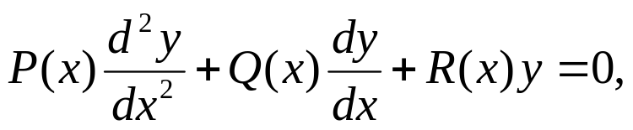
Ch 5.2: Series Solutions
Near an Ordinary Point, Part I
In Chapter 3, we examined methods of solving second order linear differential equations with constant coefficients.
We now consider the case where the coefficients are functions of the independent variable, which we will denote by x.
It is sufficient to consider the homogeneous equation
since the method for the nonhomogeneous case is similar.
We primarily consider the case when P, Q, R are polynomials, and hence also continuous.
However, as we will see, the method of solution is also applicable when P, Q and R are general analytic functions.

Slide 2
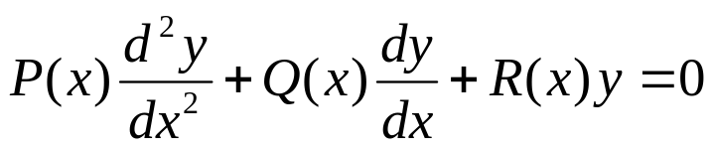
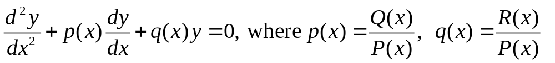
Ordinary Points
Assume P, Q, R are polynomials with no common factors, and that we want to solve the equation below in a neighborhood of a point of interest x₀:
The point x₀ is called an ordinary point if P(x₀) ≠ 0. Since P is continuous, P(x) ≠ 0 for all x in some interval about x₀. For x in this interval, divide the differential equation by P to get
Since p and q are continuous, Theorem 3.2.1 says there is a unique solution, given initial conditions y(x₀) = y₀, y'(x₀) = y₀'

Slide 3
Singular Points
Suppose we want to solve the equation below in some neighborhood of a point of interest x₀:
The point x₀ is called an singular point if P(x₀) = 0.
Since P, Q, R are polynomials with no common factors, it follows that Q(x₀) ≠ 0 or R(x₀) ≠ 0, or both.
Then at least one of p or q becomes unbounded as x → x₀, and therefore Theorem 3.2.1 does not apply in this situation.
Sections 5.4 through 5.8 deal with finding solutions in the neighborhood of a singular point.

Slide 4
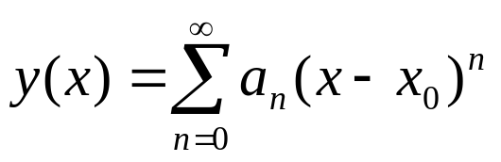
Series Solutions Near Ordinary Points
In order to solve our equation near an ordinary point x₀,
we will assume a series representation of the unknown solution function y:
As long as we are within the interval of convergence, this representation of y is continuous and has derivatives of all orders.

Slide 5

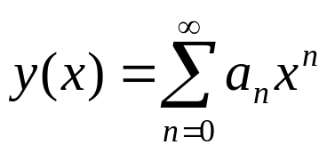
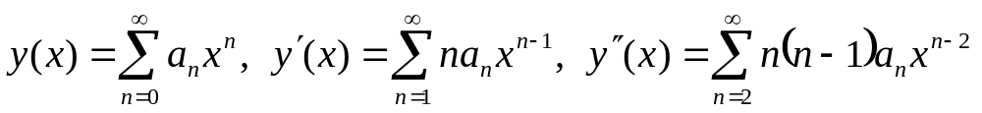
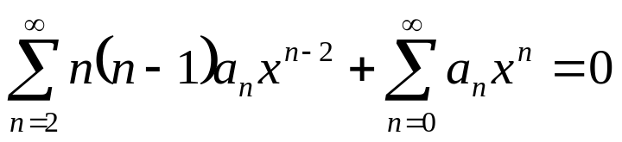
Example 1: Series Solution (1 of 8)
Find a series solution of the equation
Here, P(x) = 1, Q(x) = 0, R(x) = 1. Thus every point x is an ordinary point. We will take x₀ = 0.
Assume a series solution of the form
Differentiate term by term to obtain
Substituting these expressions into the equation, we obtain

Slide 6

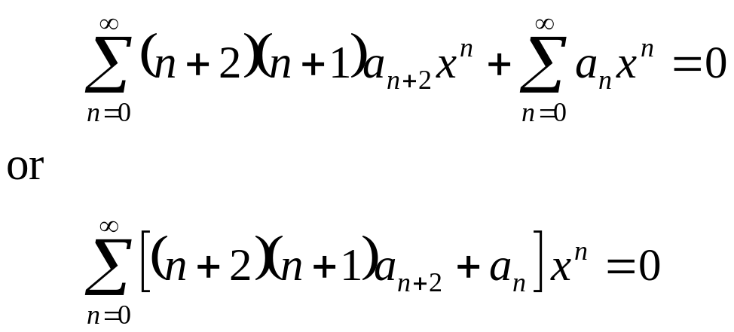
Example 1: Combining Series (2 of 8)
Our equation is
Shifting indices, we obtain

Slide 7
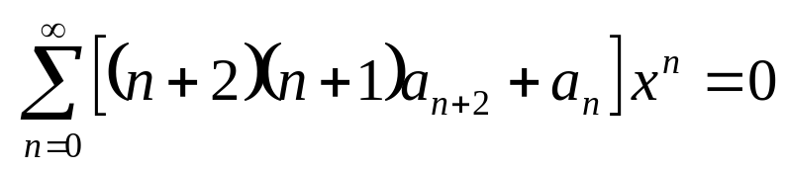
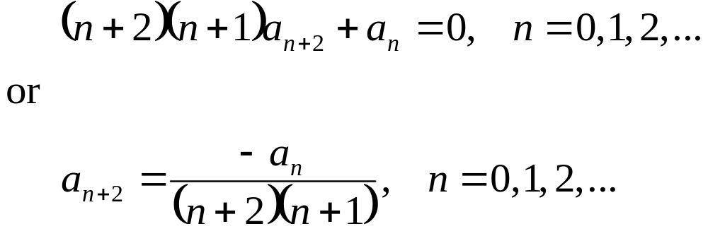
Example 1: Recurrence Relation (3 of 8)
Our equation is
For this equation to be valid for all x, the coefficient of each power of x must be zero, and hence
This type of equation is called a recurrence relation.
Next, we find the individual coefficients a₀, a₁, a₂, …

Slide 8
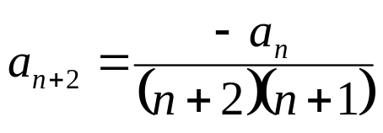
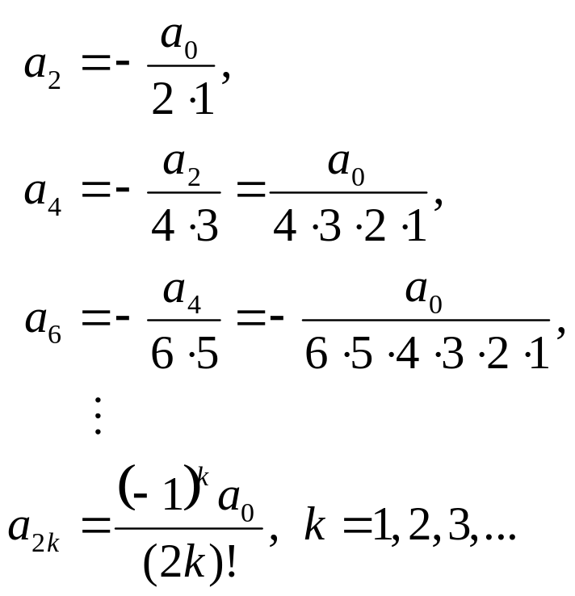
Example 1: Even Coefficients (4 of 8)
To find a₂, a₄, a₆, …., we proceed as follows:

Slide 9
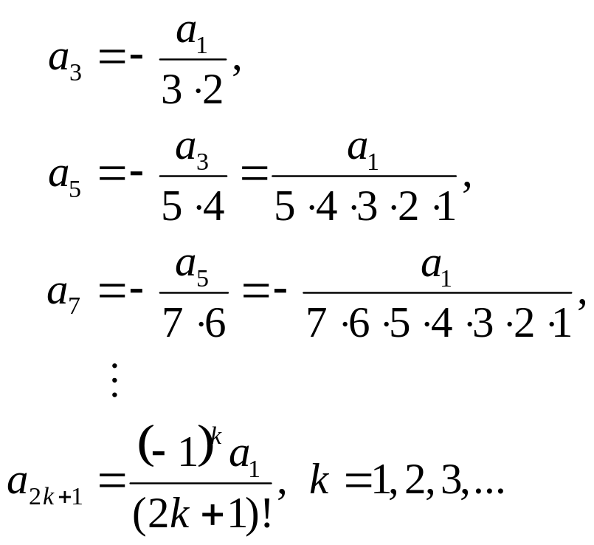
Example: Odd Coefficients (5 of 8)
To find a₃, a₅, a₇, …., we proceed as follows:

Slide 10
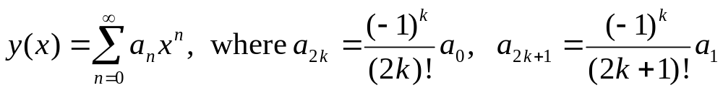
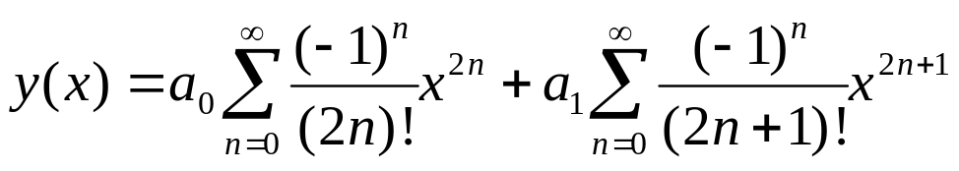
Example 1: Solution (6 of 8)
We now have the following information:
Thus
Note: a₀ and a₁ are determined by the initial conditions. (Expand series a few terms to see this.)

Slide 11

Example 1: Functions Defined by IVP (7 of 8)
Our solution is
From Calculus, we know this solution is equivalent to
In hindsight, we see that cos x and sin x are indeed fundamental solutions to our original differential equation
While we are familiar with the properties of cos x and sin x, many important functions are defined by the initial value problem that they solve.

Slide 12
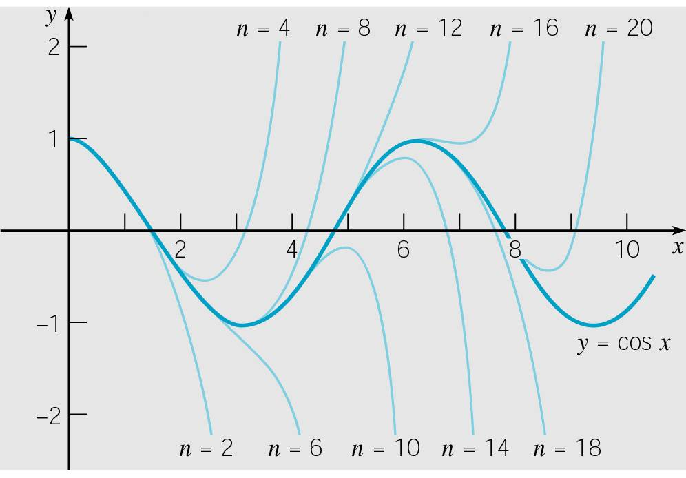
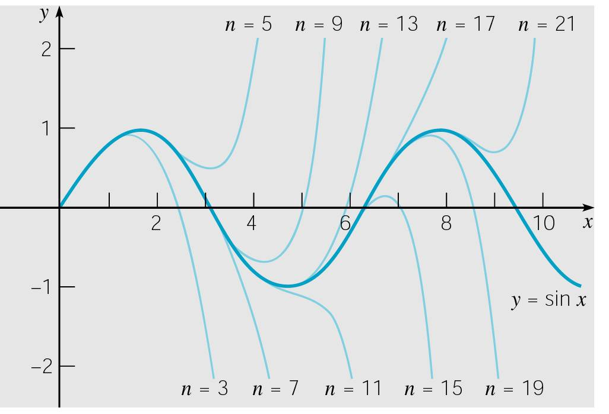
Example 1: Graphs (8 of 8)
The graphs below show the partial sum approximations of cos x and sin x.
As the number of terms increases, the interval over which the approximation is satisfactory becomes longer, and for each x in this interval the accuracy improves.
However, the truncated power series provides only a local approximation in the neighborhood of x = 0.

Slide 13

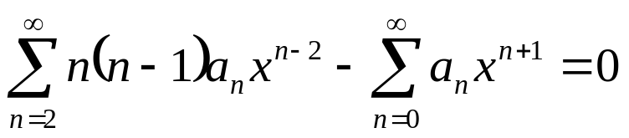
Example 2: Airy’s Equation (1 of 10)
Find a series solution of Airy’s equation about x₀ = 0:
Here, P(x) = 1, Q(x) = 0, R(x) = - x. Thus every point x is an ordinary point. We will take x₀ = 0.
Assuming a series solution and differentiating, we obtain
Substituting these expressions into the equation, we obtain

Slide 14
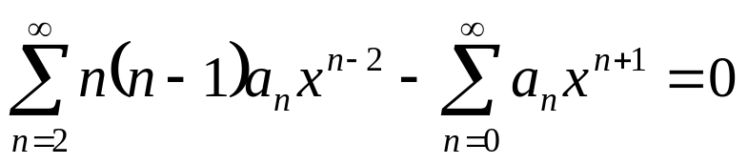
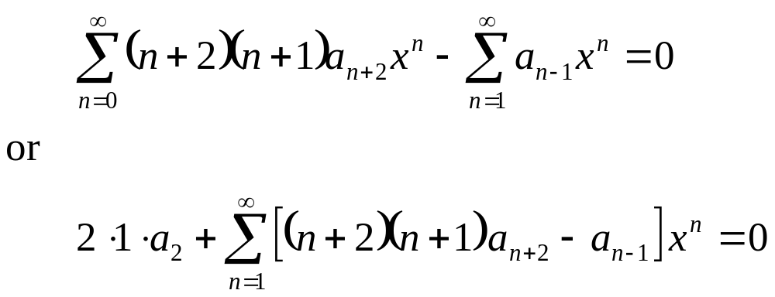
Example 2: Combine Series (2 of 10)
Our equation is
Shifting the indices, we obtain

Slide 15
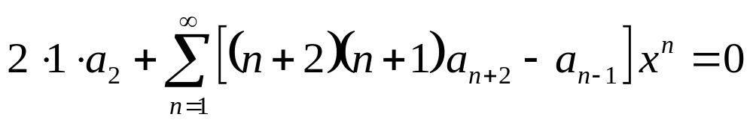
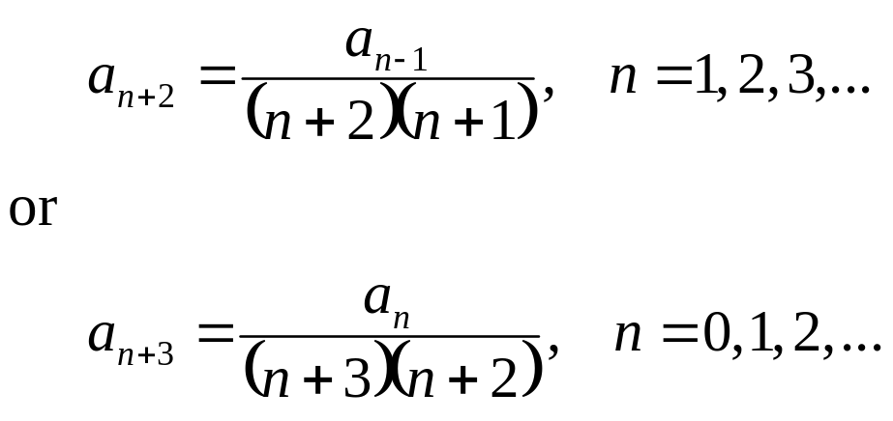
Example 2: Recurrence Relation (3 of 10)
Our equation is
For this equation to be valid for all x, the coefficient of each power of x must be zero;
hence a₂ = 0,
and

Slide 16
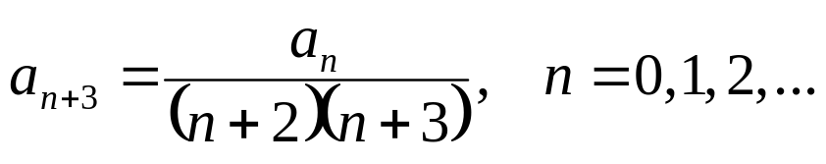
Example 2: Coefficients (4 of 10)
We have a₂ = 0
and
For this recurrence relation, note that a₂ = a₅ = a₈ = … = 0.
Next, we find the coefficients a₀, a₃, a₆, ….
We do this by finding a formula a_{3n}, n = 1, 2, 3, …
After that, we find a₁, a₄, a₇, …, by finding a formula for a_{3n+1}, n = 1, 2, 3, …

Slide 17
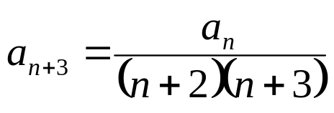
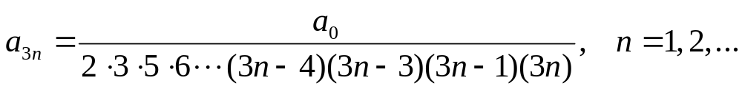
Example 2: Find a_{3n} (5 of 10)
Find a₃, a₆, a₉, ….
The general formula for this sequence is

Slide 18
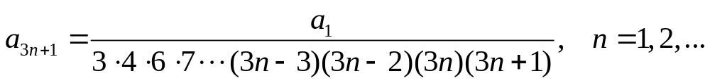
Example 2: Find a_{3n+1} (6 of 10)
Find a₄, a₇, a₁₀, …
The general formula for this sequence is

Slide 19
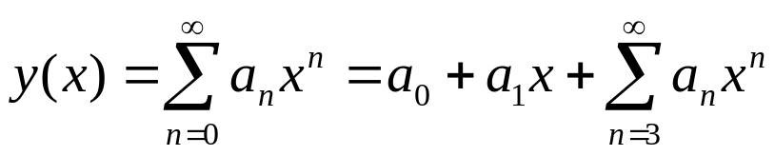
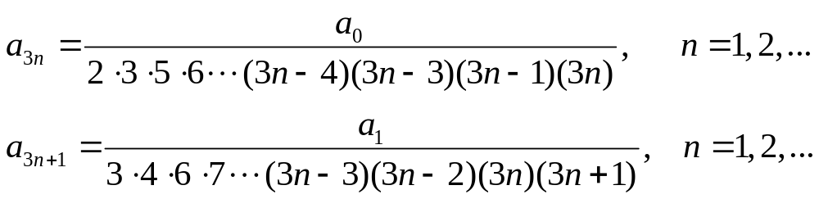
Example 2: Series and Coefficients (7 of 10)
We now have the following information:
where a₀, a₁ are arbitrary, and

Slide 20
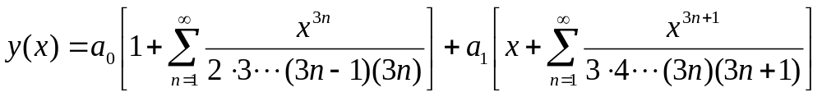
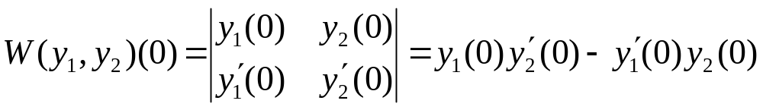
Example 2: Solution (8 of 10)
Thus our solution is
where a₀, a₁ are arbitrary (determined by initial conditions).
Consider the two cases
(1) a₀ =1, a₁ = 0 ⇔ y(0) = 1, y'(0) = 0
(2) a₀ =0, a₁ = 1 ⇔ y(0) = 0, y'(0) = 1
The corresponding solutions y₁(x), y₂(x) are linearly independent, since W(y₁, y₂)(0) =1 ≠ 0, where

Slide 21
Example 2: Fundamental Solutions (9 of 10)
Our solution:
For the cases
(1) a₀ =1, a₁ = 0 ⇔ y(0) = 1, y'(0) = 0
(2) a₀ =0, a₁ = 1 ⇔ y(0) = 0, y'(0) = 1,
the corresponding solutions y₁(x), y₂(x) are linearly independent, and thus are fundamental solutions for Airy’s equation, with general solution
y (x) = c₁ y₁(x) + c₂ y₂(x)

Slide 22
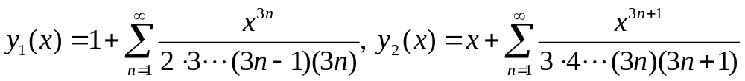
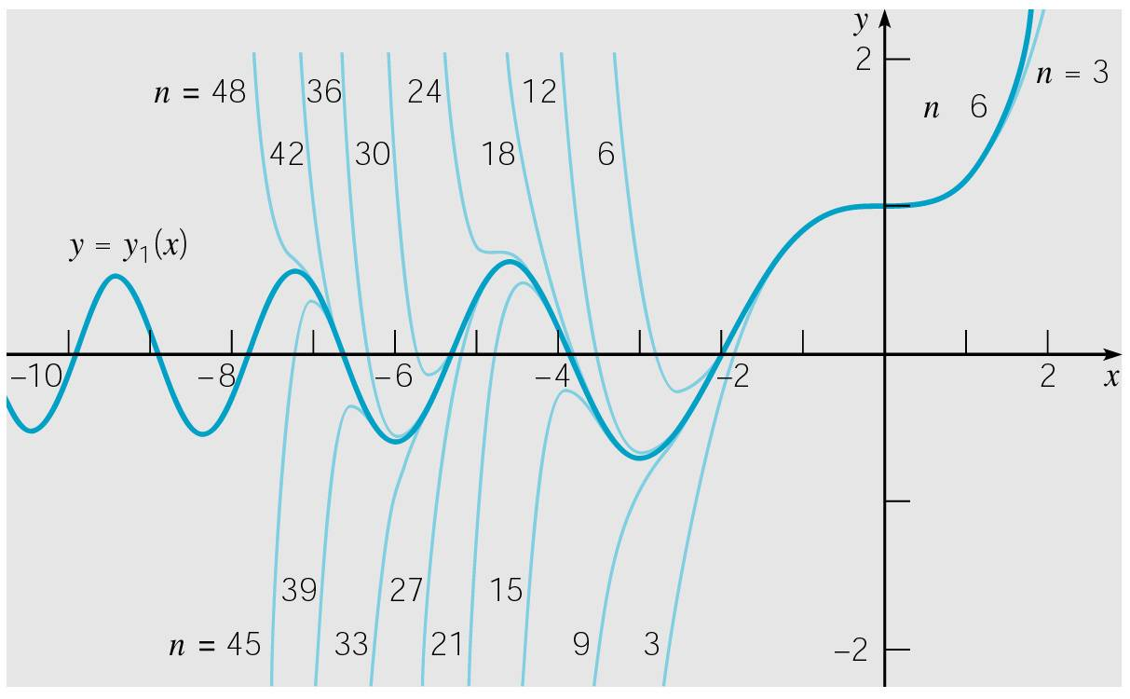
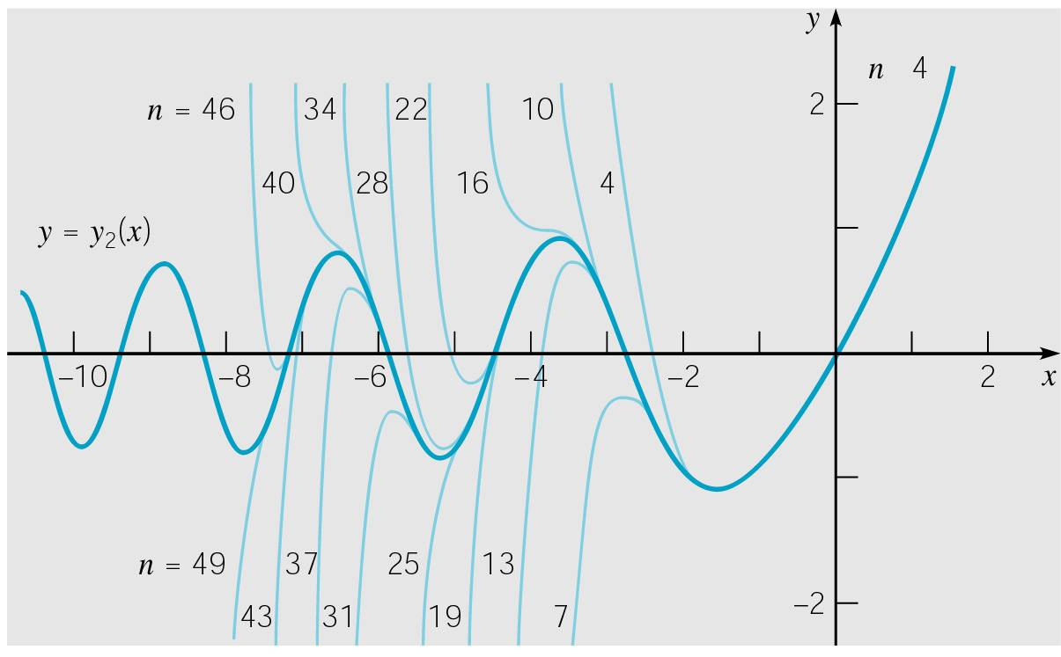
Example 2: Graphs (10 of 10)
Thus given the initial conditions
y(0) = 1, y'(0) = 0 and y(0) = 0, y'(0) = 1
the solutions are, respectively,
The graphs of y₁ and y₂ are given below. Note the approximate intervals of accuracy for each partial sum

Slide 23
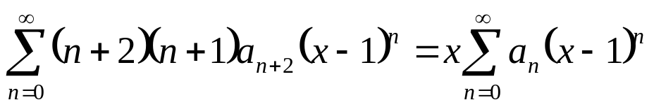
Example 3: Airy’s Equation (1 of 7)
Find a series solution of Airy’s equation about x₀ = 1:
Here, P(x) = 1, Q(x) = 0, R(x) = - x. Thus every point x is an ordinary point. We will take x₀ = 1.
Assuming a series solution and differentiating, we obtain
Substituting these into ODE & shifting indices, we obtain

Slide 24

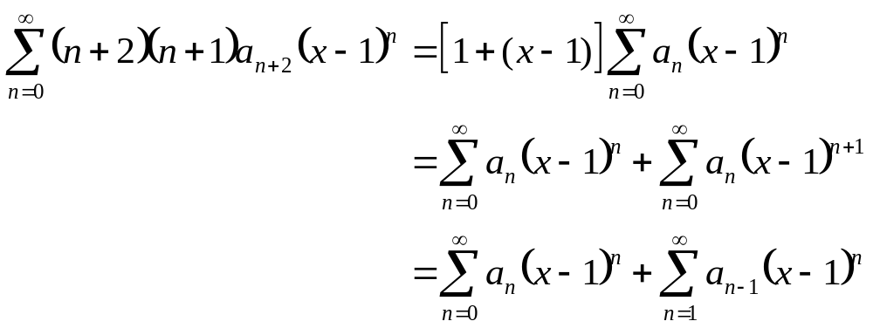
Example 3: Rewriting Series Equation (2 of 7)
Our equation is
The x on right side can be written as
    x = 1 + (x – 1)
and thus

Slide 25
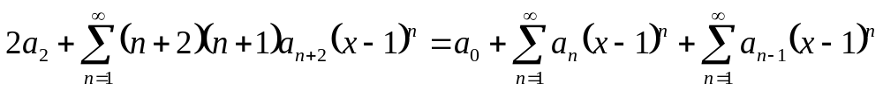

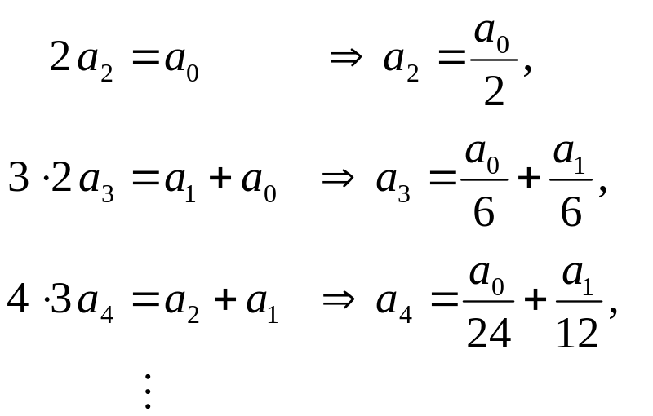
Example 3: Recurrence Relation (3 of 7)
Thus our equation becomes
Thus the recurrence relation is
Equating like powers of x -1, we obtain

Slide 26
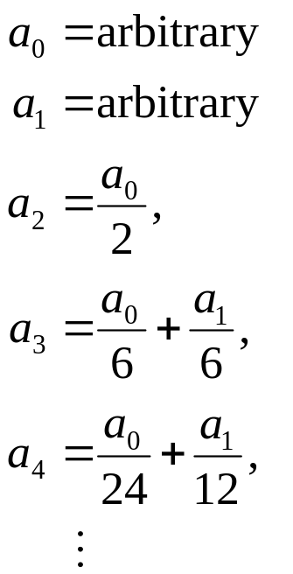
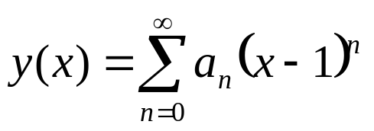
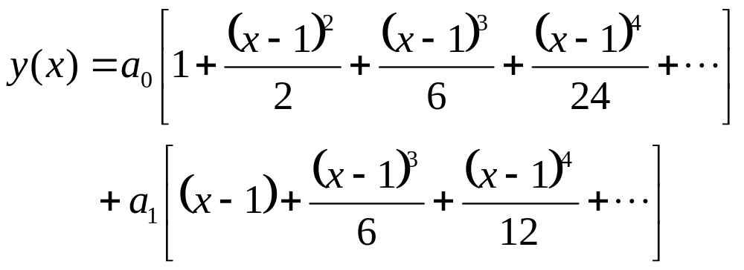
Example 3: Solution (4 of 7)
We now have the following information:
and

Slide 27
Example 3: Solution and Recursion (5 of 7)
Our solution:
The recursion has three terms,
and determining a general formula for the coefficients a_{n} can be difficult or impossible.
However, we can generate as many coefficients as we like, preferably with the help of a computer algebra system.

Slide 28


Example 3: Fundamental Solutions (7 of 7)
Our solution:
or
It can be shown that the solutions y₃(x), y₄(x) are linearly independent, and thus are fundamental solutions for Airy’s equation, with general solution

